Slide 1

BUSINESS ANALYTICS CASE STUDY
Customer Behaviour &
BusinessPerformance Analysis
Investigating customer churn for ABC Communications Ltd
Prepared by: Samuel Arthur
Role: Junior Data Analyst, AnalystLab Africa Consulting
Programme: AnalystLab Africa — Data Analytics Internship, Week 1

Slide 2
Objectives of the Analysis
01.
02.
Understanding the data
Analyze Customer Segments
Evaluate the structure, completeness, and quality of the customer dataset before drawing any conclusions.
Identify the customer segments with the highest risk of churn.
03.
04.
Visualize Key Patterns
Practical Recommendations
Use charts to highlight trends and support business decisions.
Develop data-driven strategies to strengthen customer retention at ABC Company

Slide 3
02.
Dataset Overview

Slide 4
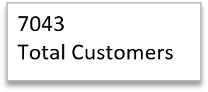

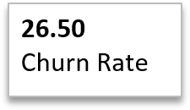
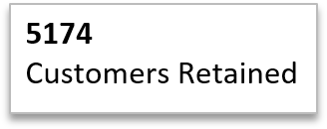
Dataset Overview
21
Data Colums
0
Duplicate Records
DATA QUALITY NOTES
Dataset sourced from Kaggle's Telco Customer Churn
the dataset was inspected for missing values, duplicates, inconsistent categories,
incorrect data types and unusual values. Necessary cleaning steps were performed
to ensure that the dataset was suitable for analysis.
No missing values or duplicate customer IDs found.
4

Slide 5
03.
Visualize Key Patterns
Use charts to highlight trends and support business decisions.

Slide 6
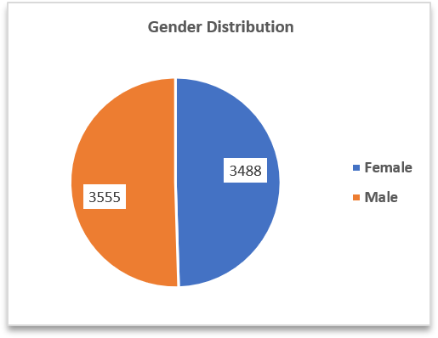
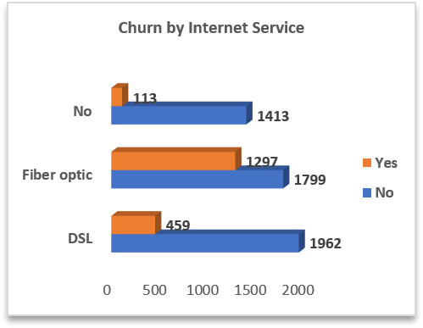
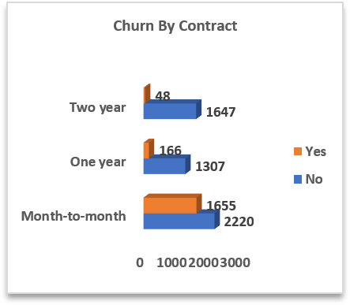
A churn rate of 26.50% shows that roughly one out of four customers are leaving the company.
Gender: The customer base is nearly evenly split between males and females, so gender does not appear to create a major imbalance.
Internet Service: Fiber-optic customers have the highest number of churned customers, making this segment a key area for retention efforts.
Contract Type: Month-to-month customers show significantly higher churn than one- and two-year contract customers, indicating that longer contracts are associated with better retention.

Slide 7
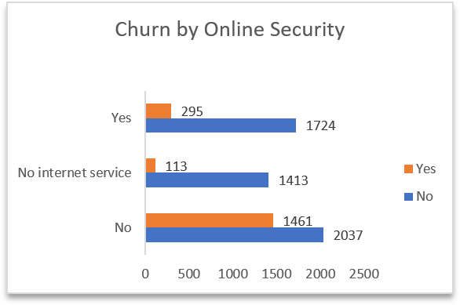
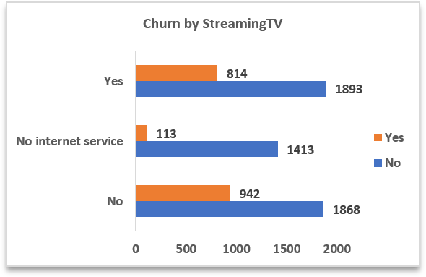
Churn by Online Security and Churn by StreamingTV
Churn by Online Security: Customers without Online Security show a higher level of churn than those with Online Security. This indicates that providing or promoting Online Security services could help improve customer retention.
Churn by Streaming TV: Customers who use Streaming TV have a relatively high number of churned customers compared with those who do not use the service. This suggests that Streaming TV customers may require additional engagement and retention efforts.

Slide 8
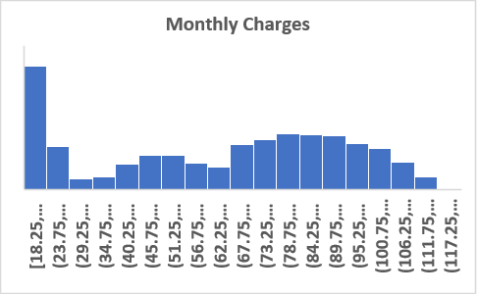
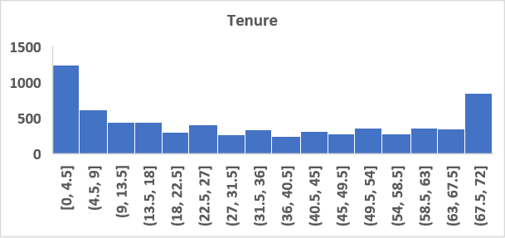
Monthly Charges and Tenure by Customers
Monthly Charges: The distribution shows that most customers are concentrated within the lower-to-middle monthly charge ranges, while fewer customers pay very high monthly charges. This suggests that the customer base is largely made up of customers with moderate monthly bills.
Tenure: The tenure distribution shows that many customers have relatively short or moderate tenure, with fewer customers staying for very long periods. This indicates that retaining newer customers should be an important priority for the company.

Slide 9
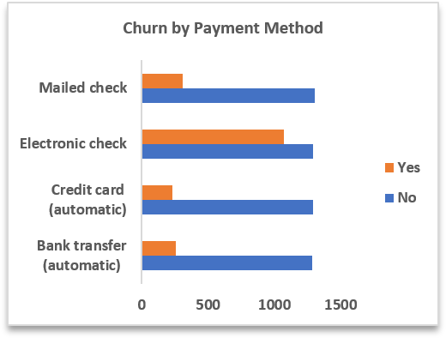
Churn by Payment Method
Payment Method: Electronic-check customers have the highest
churn, suggesting the need to investigate and address possible
issues affecting this payment group.

Slide 10
04.
Business Risk, Business Opportunity and Practical Recommendations
Strategic recommendations for reducing churn and improving customer loyalty through data-driven insights.

Slide 11
Business Risk
01.
02.
03.
Revenue Loss
High customer acquisition costs
Customer loyalty and competitive risk
A 26.50% churn rate means the company is losing a significant number of customers and recurring revenue.
Replacing customers who leave can increase marketing and acquisition expenses.
Customer loyalty and competitive risk: Continued churn, particularly among month-to-month and fiber optic customers, may indicate dissatisfaction and could allow competitors to capture these customers.
Business Opportunity
Offer discounts, loyalty rewards, or other incentives to encourage month-to-month customers to move to one- or two-year contracts.
02.
Increase value-added service adoption
03.
Promote longer-term contracts
01
Target high-risk customers with retention campaigns
Promote services such as online security and device protection to improve customer value and potentially strengthen retention.
Use customer data to identify customers most likely to churn and provide personalized offers, service improvements, or proactive support before they leave.

Slide 12
Five Strategic Strategies to Reduce Customer Churn and Improve Retention
02.
Investigate fiber-optic churn
01.
Focus on converting month-to-month customers to longer-term contracts
Investigate fiber-optic churn by collecting customer feedback on pricing, network reliability, installation, and technical support.
03.
Promote Online Security Package
by offering discounts, loyalty rewards, or bundled packages to substantially reduce churn among month-to-month subscribers and improve recurring revenue stability.
Promote Online Security packages* through discounts, bundles, or free trial periods.
05.
Monitor Churn Regularly
04.
Create onboarding programs
Monitor churn regularly by customer segment so ABC Communications can identify high-risk groups early and take preventive action.
Create onboarding programs that engage new customers during their first few months.

Slide 13
From Insights to Impact
By leveraging customer data effectively, this study demonstrates how analytics can inform smarter strategies and enhance customer retention.
THANK YOU

